Slide 1

Applying Ethical Theories in Marketing
Unit 4.2
Professor Deirdre Shaw

Slide 2
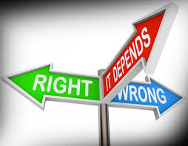
Aim
To explore differing ethical theories and apply to a consumption case.

Slide 3
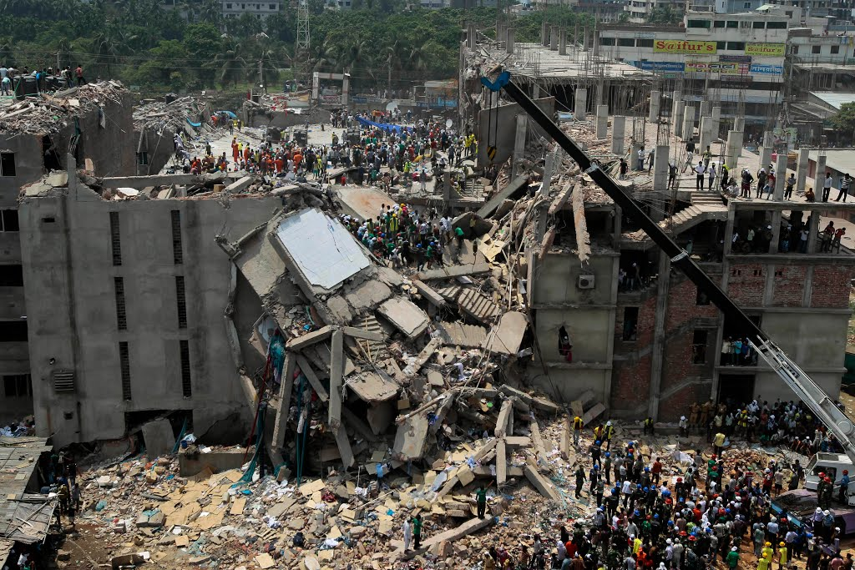
Labour exploitation
April 2013 Rana Plaza building in Bangladesh collapsed.
1,138 people killed.
2,000+ injured.
29 Western brands sourced from Rana Plaza.
Union recognition
1,100 factory inspections = over 80,000 safety issues
https://www.theguardian.com/global-development/2018/apr/24/bangladeshi-police-target-garment-workers-union-rana-plaza-five-years-on

Slide 4
What would be the right course of action for the:
Consumer?
Aim
Locate the role of ethical theory.
Explore and provide a critical overview of traditional ethical theories.

Slide 5
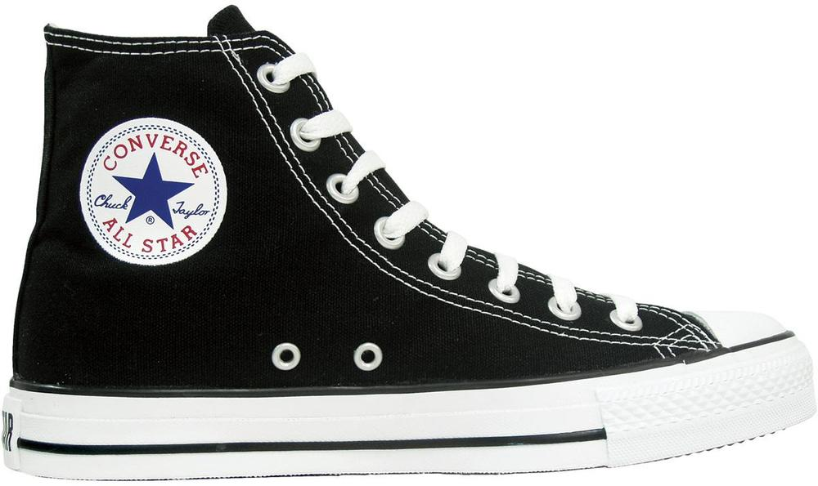

Slide 6
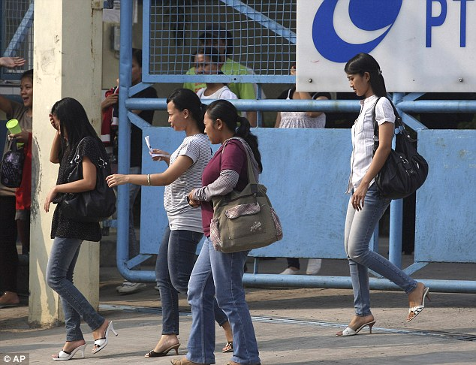
Workers at the Sukabumi plant, about 60 miles from Jakarta, say supervisors frequently throw shoes at them, slap them in the face, kick them and call them dogs and pigs. Read more: http://www.dailymail.co.uk/news/article-2014325/Nike-workers-kicked-slapped-verbally-abused-factories-making-Converse-line-Indonesia.html#ixzz3KZJvlOuw

Slide 7
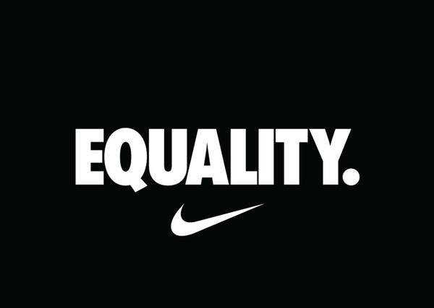
Two female former Nike employees in Oregan, USA, sued Nike for creating a culture of gender discrimination and sexual harassment. Complaints included being called “dykes” and being send nude photos from a male co-worker.
Read more: https://www.thefashionlaw.com/nike-slapped-with-gender-discrimination-hostile-workplace-lawsuit/?rq=nike

Slide 8
Corporate ‘wrongdoing’ (Schwartz, 2010, p. 1)
Physical abuse of workers
Mental abuse of workers

Slide 9

CNSR decisions (Devinney et al., 2010 p. 11)
What would it be right for a consumer to do?
Buy Converse All Stars
Seek further information before possibly buying
Boycott Converse All Stars
Boycott and tell others about the ‘wrongdoing’

Slide 10

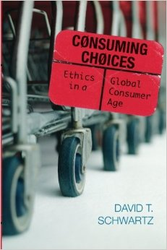

Ethical Theory
Ethical theories are the rules and principles that determine right and wrong for any given situation.
(Crane and Matten, 2016)
Consequentialism
Deontology
Virtue theory

Slide 11
Concerned with Consequences
Consequentialism
Calculating what is right to do from the consequences of the action.
We act correctly when we maximise the general good.
Whether an act is right or wrong depends only on the results of that act.
The more good consequences an act produces, the better or more right that act is.
A person should choose the action that maximises good consequences.
People should live so as to maximise good consequences.

Slide 12
Must Follow Rules
Deontology
Concerned with finding and applying ‘universal’ rules or principles to decide what is right to do.
We act correctly when we comply with rules.
For example, do to others what we would have them do to us (‘golden rule’).
Morality is a matter of duty, compliance to a moral law.
Whether something is right or wrong doesn’t depend on its consequences but the nature of the act.

Slide 13
Must be Good
Virtue Theory
Concerned with the qualities we each should cultivate to live a flourishing and virtuous life.
We act correctly (and flourish) when we are virtuous.
Analyses the rightness or wrongness of individual choices indirectly in terms of the character or dispositions of the agent making the choices.
Moral virtue is a matter of performing well in the function of being human.
Practice is important to achieve excellence and that provides motivation.
Virtues are intellectual or character traits or habits developed throughout one’s life.

Slide 14
Calculations or Dilemmas?
Consequentialism and Deontology
Require calculations
What will be the outcome of my actions?
What rule should I follow in this situation?
Virtue Theory
Requires thinking about who we are
What would a person of integrity do in these circumstances.?

Slide 15
Consequentialism
Calculating what is right to do from the consequences of the action
“For if the harm I am causing is imperceptible, would not my culpability also be something approaching the imperceptible?”
“…. an imperceptibly harmful act may be morally wrong despite its unnoticed effects.” (Schwartz, 2010, p.64)
Consumers (and marketers) are proportionally culpable for harm caused.
Any good achieved through buying the shoe is far out weighed by the harm caused.
“… most good may well come not from ones actual boycott but from one’s success in encouraging others to boycott.” (Schwartz 2010, p.66)

Slide 16
Consequentialism
Calculating what is right to do from the consequences of the action
“… the magnitude of [wage] inequalities deserves scrutiny.”
“… while the ‘lucky’ sweatshop workers may in fact be adequately paid, this does nothing for those many ‘unlucky’ sweatshop workers for whom these relativities do not obtain ...”
“… focus more on improving sweatshop working conditions than on lifting wages [because] this would offer better chances of an actual decrease in suffering …” (Schwartz 2010, p104)

Slide 17
Consequentialism
Calculating what is right to do from the consequences of the action
“… sweatshops are a kind of economic growing pain on the road to an economy that can build wealth.”
Low wages are relative to the location
Unemployment is often the alternative
“… while painful now, this sweatshop is actually laying the groundwork for higher standards of living in the future.” (Schwartz 2010, p.103)

Slide 18

CNSR decisions
What would it be right for the consumer to do?
Sweatshops are a stage on the way to wealth creation.
Sweatshop wrongdoing should be boycotted by affluent consumers.

Slide 19
Deontology
Concerned with finding and applying ‘universal’ rules or principles to decide what is right to do.
“I am accountable for what others do when I intentionally participate in the wrong they do or harm they cause […] independently of the actual difference I make.” (Schwartz 2010, p.71)
“The wrongness of buying … resides in my principled treatment of these workers as mere means of satisfying my desires.” (Schwartz 2010, p.80)

Slide 20
Deontology
Concerned with finding and applying ‘universal’ rules or principles to decide what is right to do.
Consumers (and marketers) are essential to the success of consumer culture.
“In purchasing a morally tainted product, I am intentionally participating in a collective wrongdoing that may involve production, marketing, transportation, or consumption of that product.” (Schwartz 2010: p80)

Slide 21
CNSR decisions
Are customers complicit in corporate wrongdoing because they participate?

Slide 22
Virtue Theory
Concerned with the qualities we each should cultivate to live a flourishing and virtuous life
Traditional Virtues
“frugality, appreciation, temperance, self-development, dedication, benevolence, generosity, empathy, and justice” - foster human flourishing around the world
Traditional Vices
“greed, avarice, gluttony, envy, luxury, pride …. intemperance, selfishness, and indifference” – foster lifestyles that diminish human wellbeing (Wenz 2005, p.197)

Slide 23
Virtue Theory
Concerned with the qualities we each should cultivate to live a flourishing and virtuous life
Consumerism harms the environment
“Attempts at unlimited consumption, pursued as an end in itself, degrade the environment. Global warming, for example, threatens species with extinction because of the rapid climate change.” (Wenz, 2005, p.198)
Consumerism harms poor people in the ‘third world’
“Gross statistics show that on balance consumerism increases income gaps between the world’s rich and poor and jeopardizes food supplies for the poor.” (Wenz, 2005, p.203)

Slide 24
Virtue Theory
Concerned with the qualities we each should cultivate to live a flourishing and virtuous life
Consumerism harms ‘industrial’ people
“Consumer items can also impair a sense of community. … cars have enabled people to move to suburbs where they live further from neighbours …” (Wenz, 2005, p.204)
“In consumer society people look for love in all the wrong places and remain frustrated … and [this] impairs the ability of industrial [affluent] people to lead fulfilling lives.” (Wenz, 2005, p.205)

Slide 25
Virtue Theory
Concerned with the qualities we each should cultivate to live a flourishing and virtuous life
Vices have become ‘virtues’ in consumerism e.g. envy is essential in a consumer society “Consumers must envy the life of those with the product, or they would not buy it.”
Virtues inhibit the consumerism that impairs human flourishing e.g. frugality “getting good value for every minute of your life energy and from everything you have the use of … waste lies not in the number of possessions but in the failure to enjoy them” (Wenz, 2005, p.206-207)

Slide 26
CNSR decisions
What would it be right for a consumer to do?
Buy Converse All Stars
Seek further information before possibly buying
Boycott Converse All Stars
Boycott and tell others about the ‘wrongdoing’

Slide 27
CNSR decisions
Select which philosophical theory each of these statements exemplifies
We should only buy products where workers are treated as we ourselves would find acceptable.
The most effective way to minimise harm to workers is to campaign against producer wrongdoing.
We should strive to live a more frugal life than those around us.
Although many workers in poorer economies currently toil under difficult conditions, the eventual outcome will benefit all.
Marketers have a moral obligation to respond truthfully to enquiries from potential customers about the treatment of workers in production processes.
deontology
consequentialist
virtue theory
consequentialist
deontology

Slide 28
Pluralism
All theoretical approaches shed light from different angles on a problem.
Complementary rather than mutually exclusive.
(Crane and Matten, 2010)

Slide 29
Final Thoughts
These theories rarely provide us with a clear-cut, unambiguous, and non-controversial solution
Ethical theories are at best tools to inform the ‘moral sentiment’ of the decision-maker
Ethical theories might help to structure and rationalise some of the key aspects of those decisions, but their status can never be one that allows a moral judgement or decision to be made without effectively immersing into the real situation

Slide 30
References
Barnett, Clive, Philip Cafaro and Terry Newholm (2005) ‘Philosophy and Ethical Consumption’ pp11-24 in Rob Harrison, Terry Newholm and Deirdre Shaw (eds.) The Ethical Consumer London: Sage.
Crane, A. and Matten, D. (2016) Business Ethics, Oxford University Press: Oxford, Chapter 3 (Evaluating Business Ethics), p.85.
Devinney, Timothy M., Pat Auger, Giana M. Eckhardt (2010) The Myth of the Ethical Consumer Cambridge University Press.
Nike workers 'kicked, slapped and verbally abused' at factories making Converse (2011) Daily Mail, 13 July.
https://www.theguardian.com/global-development/2019/oct/14/workers-making-lululemon-leggings-claim-they-are-beaten
https://www.independent.co.uk/life-style/food-and-drink/tonys-chocolonely-chocolate-brand-plans-end-slavery-netherlands-teun-van-de-keuken-a8874801.html

Slide 31
References
Schwartz, David T. (2010) Consuming Choices: Ethics in a global consumer age Lanham: Rowman and Littlefield.
Wenz, Peter (2005) ‘Synergistic Environmental Virtues: Consumerism and human flourishing’ pp197-213 in Ronald Sandler and Philip Cafaro (eds.) Environmental Virtue Ethics Lanham, MD: Rowman and Littlefield.
Acknowledgement: Dr Terry Newholm

Slide 32

Please bring any questions about this Unit to the weekly surgery session.

